Slide 1
Hpcs hr paNEL
Developed by:
Yash Mittra
09014803115
(WEB APPLICATION Development project)

Slide 2
What is the hr panel?
HPCS HR Panel (Web App) is the go to portal for the Human Resources Manager to keep statistical analysis of all the employees.
This makes the daily tasks of the HR Manager easier and helps in extracting the maximum efficiency in terms of performance as well as resourcefulness.
A web application which incorporates the basic duties of the HR Manager in a computing atmosphere, thus making it easier for the HR to evaluate the employees in a heuristic manner.

Slide 3

HTML5
CSS3
JAVASCRIPT
TECHNOLOGIES
USED
JQUERY
BOOTSTRAP
SQL
PHP
AJAX

Slide 4

SECURE
LOGIN PANEL
COMPLETELY ONLINE
ADD /VIEW /EDIT
EMPLOYEES
FEATURES
EMPLOYEE ATTENDANCE
STATISTICS
USES
HASHED
PASSWORDS
EMPLOYEE CHECKLISTS

Slide 5
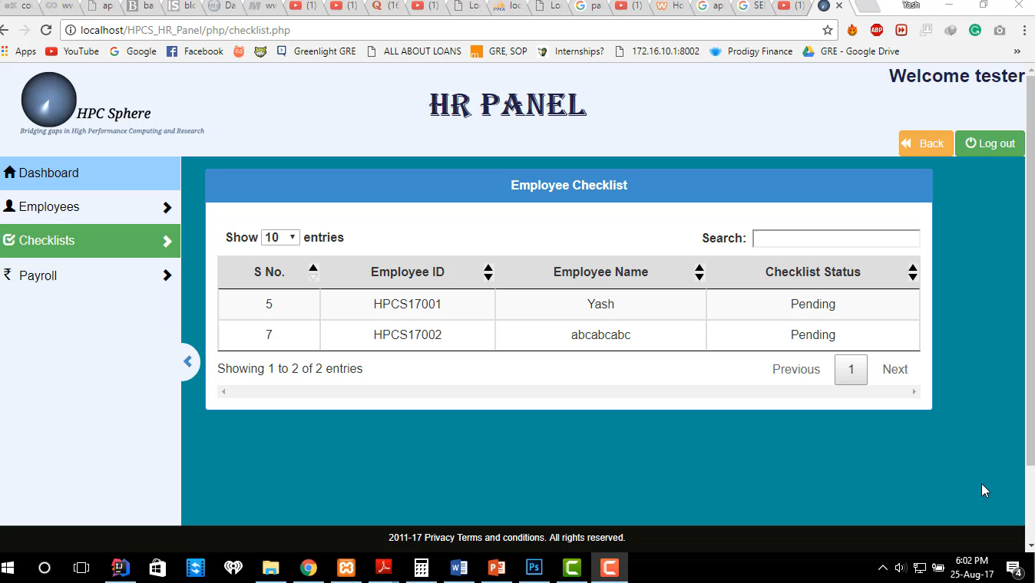
Salient features
AN EXAMPLE OF SECURE LOGIN PANEL
- HERE WE SHOW WHAT HAPPENS IF AN UNAUTHORIZED USER TRIES TO ACCESS A WEBPAGE THAT HE SHOULDN’T BE ABLE TO ACCESS.
- AS A RESULT, HE IS REDIRECTED TO THE LOGIN PANEL

Slide 6

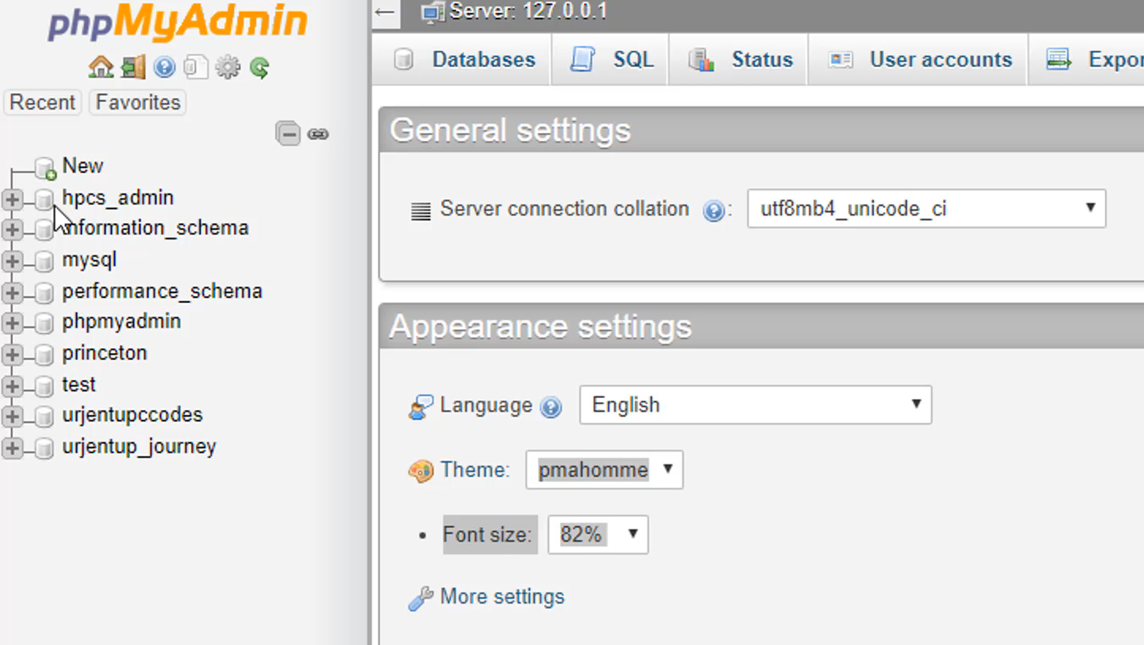
TABLES

Slide 7

The Login Panel
Adding Employees
Viewing Employees
CONTENTS
Updating Employees
Employee Attendance
Checklists & Payroll
Conclusion

Slide 8

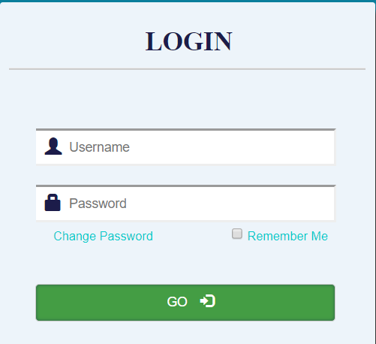
THE LOGIN PANEL
Uses the table `login`
Remember Me Feature
(Uses Cookies)
Change Password Feature

Slide 9

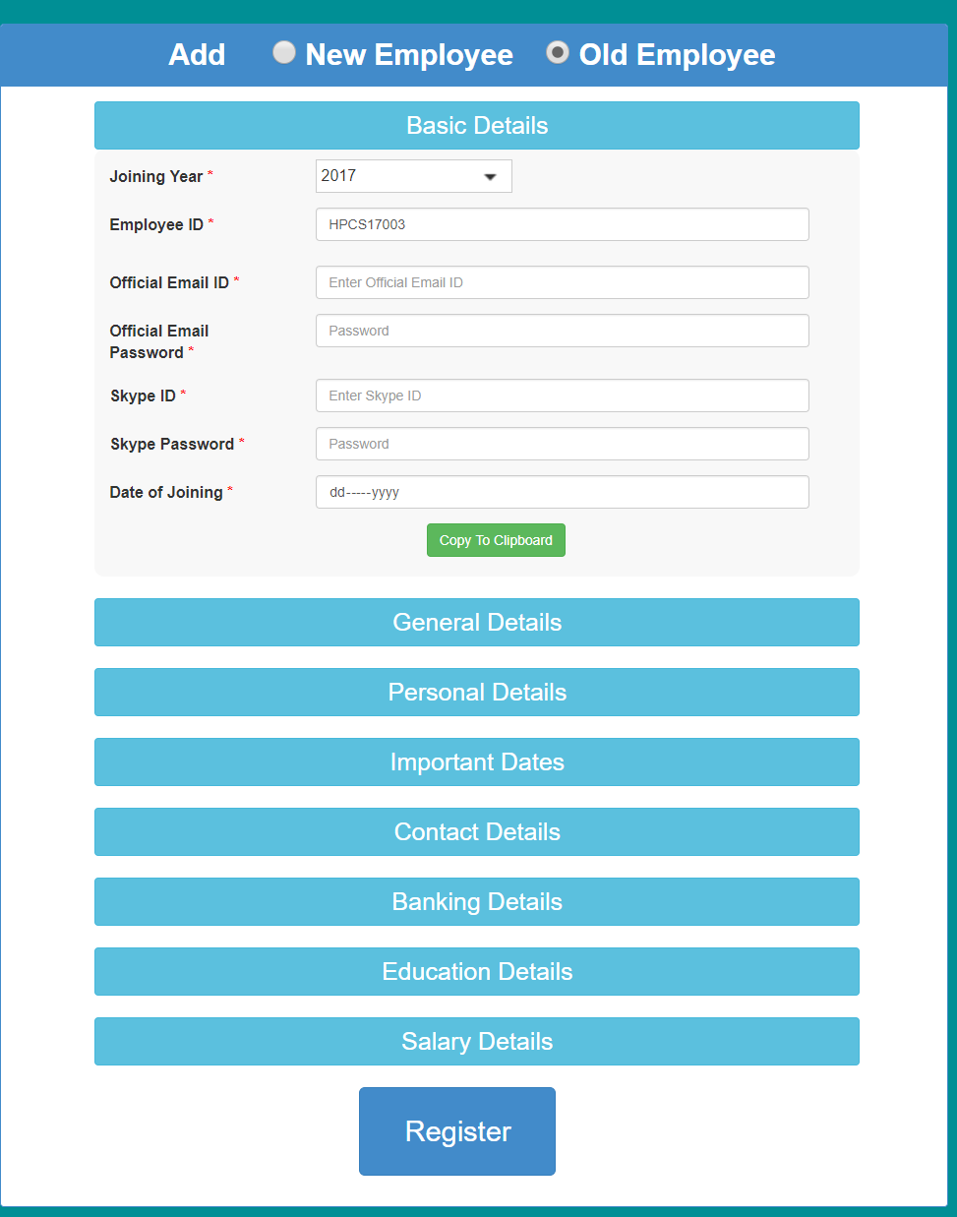
Adding
Employees
Uses the table `employees`
Employee ID auto-generated
Easy and Facile Interface

Slide 10

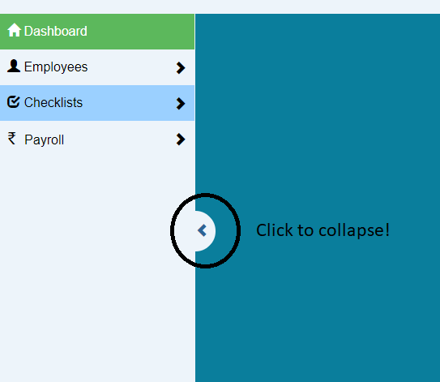

THE NAVBAR
Collapse and Restore Feature
Path Marking
Hover for
Sub-Menu

Slide 11
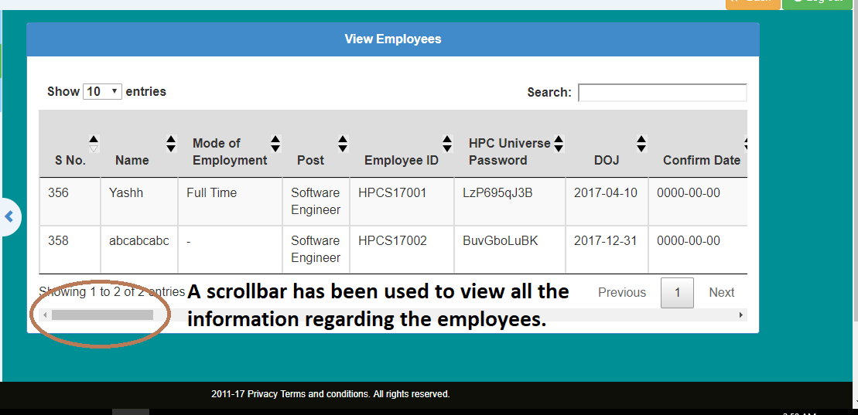
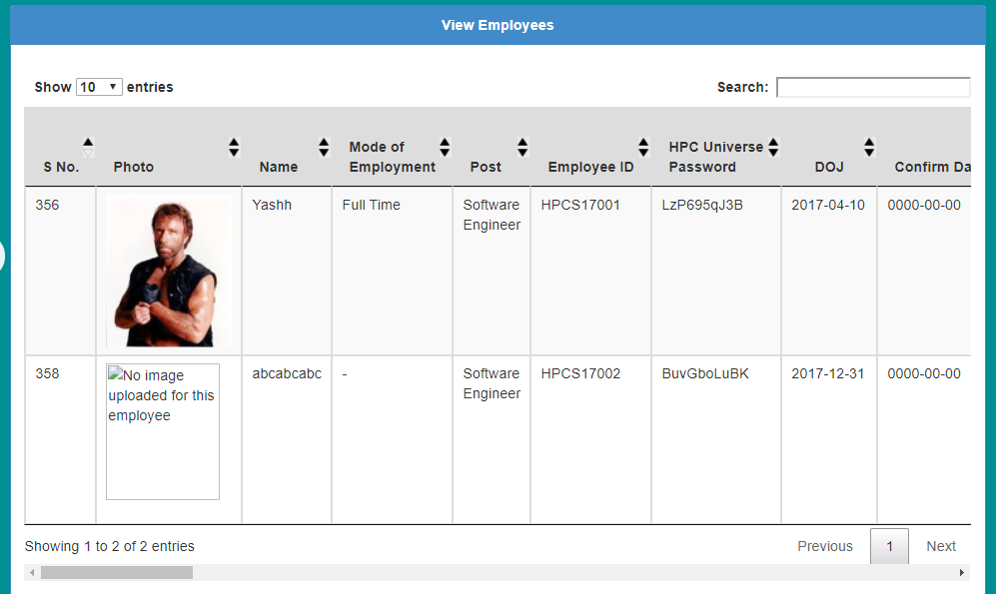
VIEWING
EMPLOYEES
Uses the table `employees`
Two interfaces:
- With Photos
- W/O Photos
Quick Search and Sort

Slide 12

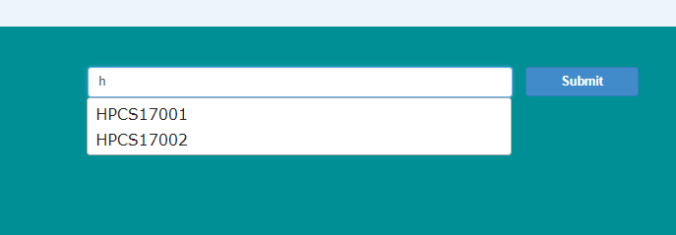
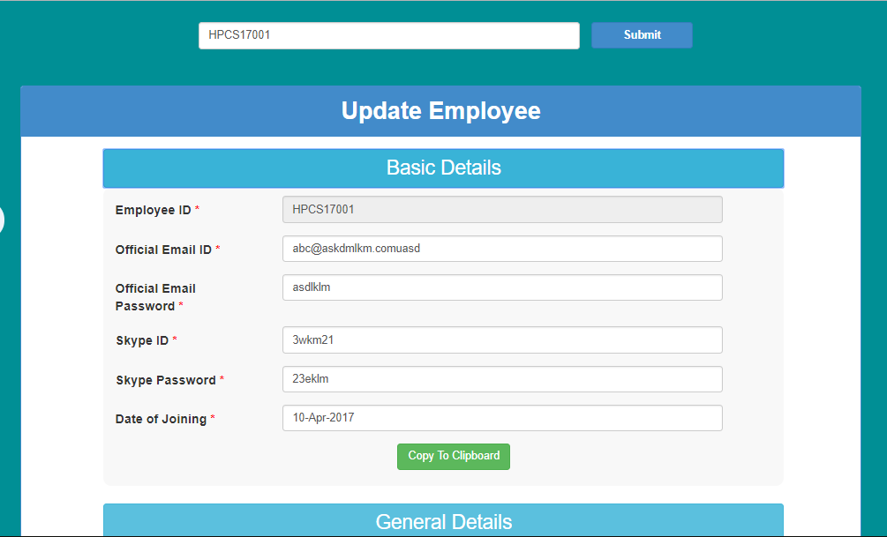
Updating
Employees
Uses the table `employees`
Auto-Suggest Search
Employee ID Unalterable

Slide 13
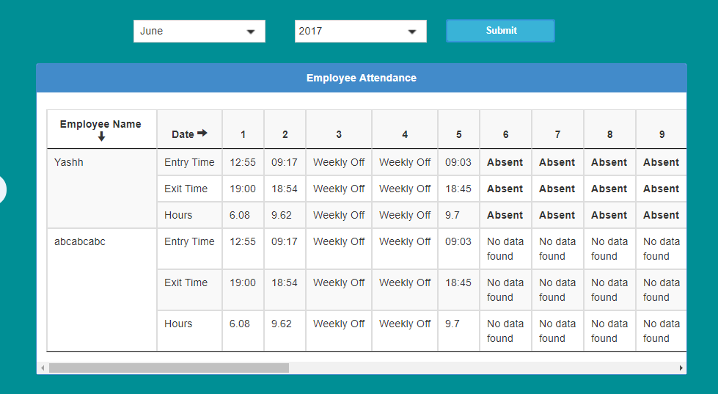
EMPLOYEE ATTENDANCE
Uses the table `attendance`
Shows all Employees’ Attendance at Once For Each Month & Year

Slide 14
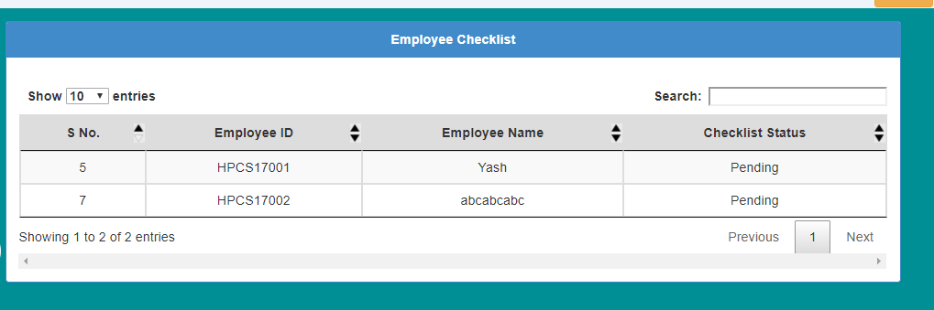
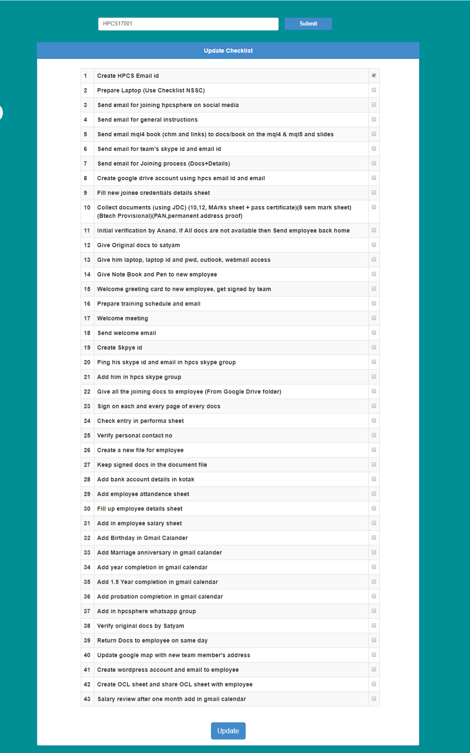
EMPLOYEE CHECKLISTS
Uses the table `checklists`
Two Parts:
- Checklist Status
- Checklist Update
Uses Database Events

Slide 15
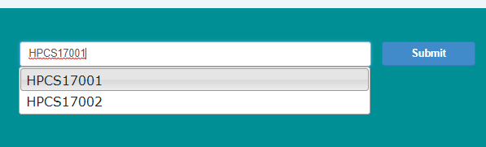
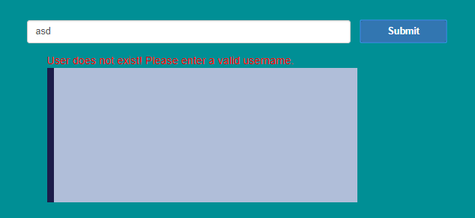
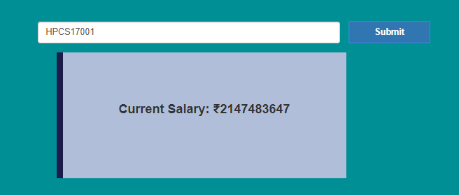
EMPLOYEE
PAYROLL
Uses the table `employees`
Auto-Suggest Search
Easy Payroll View ability

Slide 16

PROGRESS
EASE OF ACCESS
MANAGEABILITY
CONCLUSION
ANALYSIS
STATISTICS
COLLABORATION

Slide 17

TUTORIALSPOINT
REFERENCES
STACKOVERFLOW
W3SCHOOLS

Slide 18


